Slide 1
Capstone Engagement
Assessment, Analysis, and Hardening of a Vulnerable System

Slide 2
Table of Contents
This document contains the following sections:
01
Network Topology
02
Red Team: Security Assessment
03
Blue Team: Log Analysis and Attack Characterization
Hardening: Proposed Alarms and Mitigation Strategies
04

Slide 3
Network Topology
‹#›

Slide 4
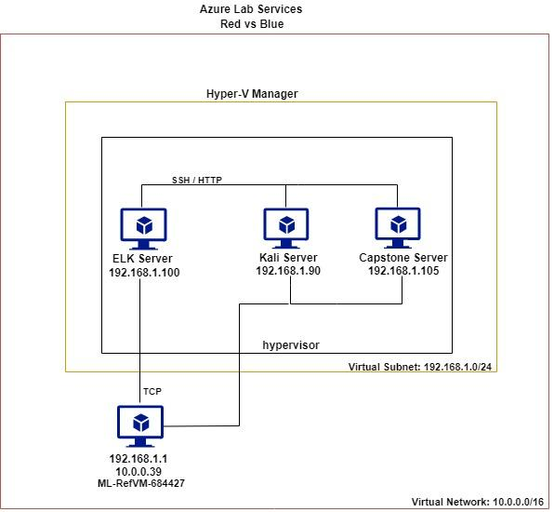
Network Topology
Network
Address Range: 192.168.1.0/24
Netmask: 255.255.255.0
Gateway: 192.168.1.1
Machines
IPv4: 192.168.1.1
OS: Windows 10 Pro
Hostname: ML-RefVm-684427
IPv4: 192.168.1.105
OS:Linux; CPE: cpe:/o:linux:linux_kernel
Hostname: server1
IPv4: 192.168.1.100
OS:Linux; CPE: cpe:/o:linux:linux_kernel
Hostname:ELK
IPv4: 192.168.1.90
OS: Linux; CPE: cpe:/o:linux:linux_kernel
Hostname:Kali

Slide 5

Red Team
Security Assessment
‹#›

Slide 6
Recon: Describing the Target
Nmap identified the following hosts on the network:
Hostname | IP Address | Network
ML-RefVm-68442 | 10.0.0.39 / 192.168.1.1 | Host, Hyper-V, hypervisor, virtual machine monitor
Kali | 192.168.1.90 | Attacking machine, Kali Linux with exploit tools and libraries
Capstone | 192.168.1.105 | Victim machine,running filebeat, metricbeat, and packetbeat to provide log files, network data, and server metric output to Kibana running on ELK.
Elk | 192.168.1.100 | Logs and metrics Kibana Tools for metrics and logs

Slide 7
Vulnerability Assessment
The assessment uncovered the following critical vulnerabilities in the target:
Vulnerability | Description | Impact
CWE-200: Exposure of sensitive information to an unauthorized Actor. CWE-209: Generation of error message containing sensitive information | Attackers are able to gather information from plain text files stored without protection on the Web Server. The login prompt generates a message the has user information in it. | This vulnerability allows attackers to gather information about the system and how to best to attack it. User login credential information was gathered and use to breach the web server perimeter.
CWE-307: Improper restriction of excessive authentication attempts | Login prompts have no restrictions on the number of login attempts. | This vulnerability allows attackers to use brute force software to find working login credentials and was made easier with the knowledge of the exposed usernames.
CWE-494: Download of code without integrity check. | Files can be uploaded without being scanned for malicious content. | Vulnerability allows attackers to upload malware and malicious packages. We used this vulnr to upload reverse_tcp attack.

Slide 8
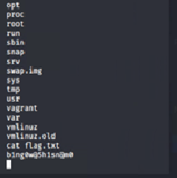
Exploitation: Remote File Inclusion Vulnerability
01
02
03
Tools & Processes
We used Msfvenom; php/meterpreter/reverse_tcp to create a reverse http payload file: go.php. We then used the open ftp connection to dav://192.168.1.105/webdav/, and dropped the go.php file into the /webdav/ folder. We went back to the browser, and we navigate to http://192.168.1.105/webdav/go.php causing the reverse_tcp exploit to load and make a call back to our server via the ip address and port (ip192.168.1.90 port 3790) that we have set in the dropped go.php exploit file. On our Kali attack server we run Metasploit and set it to use php/meterpreter/reverse_tcp payload, which sets it to expect a call back to 192.168.1.90 on port 3790 thus putting our attack server in listening mode on ip192.168.1.90 port 3790.
Achievements
When the call back is received successfully on the Kali attack server, a meterpreter command & control session is then opened and allows us to shell into the Capstone file system.
We then use the a meterpreter shell session to walk the files system directories where we were able to capture the flag in the /$ flag.txt file. When we cat the flag.txt file, the flag is: “bing0w@5h1sn@m0”.

Slide 9
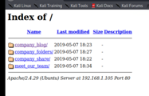
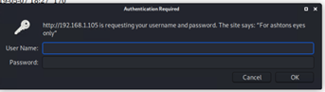
Exploitation: Brute Force Web App Server Directories
01
02
03
Tools & Processes
We used nmap to scan the network range, and identify the Capstone Server ip address and open ports. We discovered that port 80 was opened and running HTTP. We accessed the Capstone ip192.168.1.105 address via web page browser. Since the index was exposed to the public, we did not use a brute force tool like dirbuster. We instead used the url search bar to directory walk the site index and read comments from the companies team members.
Achievements
This information gave us *names, corp org chart information, and alerted us that there was a company_folders/secret_folder that was no longer publicly available. When we searched for the company_folders/secret_folder url we received an authentication prompt “For ashton's eyes only”
We used this reconnaissance information to plan an additional attack.

Slide 10
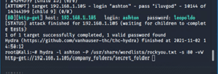
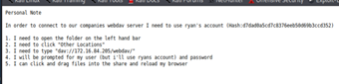
Exploitation: Brute Force Authentication on Web App Server
01
02
03
Achievements
Tools & Processes
We needed to determine what the password would be for ashton to access the company_folders/secret_folder. To do this we used Hydra to brute force the company_folders/secret_folder web page authentication prompt, with the user:ashton and a db list of common/known passwords stored in Rockyou.txt. This attack revealed ashton:leopoldo credentials, which we used to login to the company_folders/secret_folder
This attack yielded ashton:leopoldo credentials which we used to login to the company_folders/secret_folder.
On gaining access to the company_folders/secret_folder directory we were able to see and access the connecting_to_webdav file that was stored there. This file revealed instructions on the location of the webdav and on how to access it. It also gave us the password hash for user “ryan” (corp ceo – based on text info revealed so far). This information was used to further our attack.

Slide 11
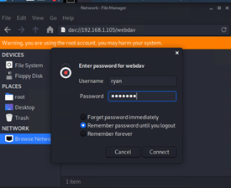
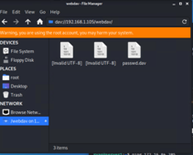
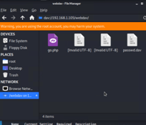
Exploitation: Password Hash Cracking
01
02
03
Tools & Processes
Since we had ryan:(*hash: d7dad0a5cd7c8376eeb50d69b3ccd352), we used John the Ripper and Crackstation to crack the password hash, resulting in ryan:linux4u
.
Achievements
We used the Linux File Manager to browse to the dav://192.168.1.105/webdav/ location and successfully logged into the webDav directory with the cracked ryan:linux4u credentials.
This gave us ftp access and permission that allowed us to drop a malicious file into the /webdav/ directory
We then copied the go.php file that was created with Msfvenom and created to call back to us at our Kali attack server (ip192.168.1.90 port 3790) - where we will be waiting to receive the call back and connect to it with Metasploit for command & control.

Slide 12

Blue Team
Log Analysis and Attack Characterization
‹#›

Slide 13
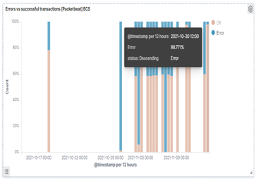
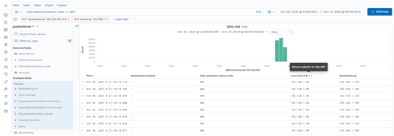
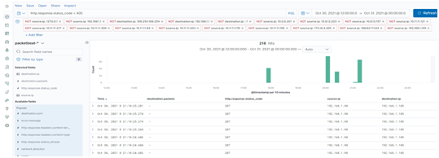
Analysis: Identifying the Port Scan
On 10/30/21 we can see a port scan from 192.168.1.90. - 218 packets received responses less that 400, and 320,168 had response messages 400 or greater.
A total of 320.386 packets were sent from 192.168.1.90 . The port scan was indicted by the spike in request with >=400 errors since most ports were shut down.

Slide 14
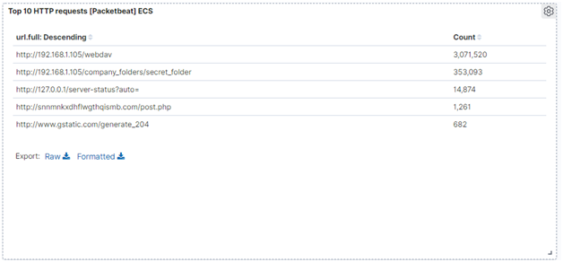
Analysis: Finding the Request for the Hidden Directory
At 12pm 58 requests were made to the hidden webdDav server and directory.
Go.php - which contained a reverse_tcp exploit and the passwd.dav file.
There were 3,071,520 events directed at the /webdav between 9/26/21 and 11/08/21

Slide 15
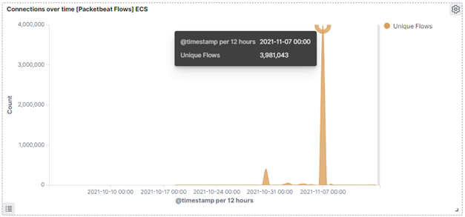
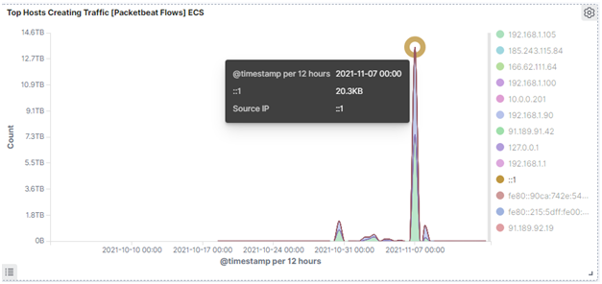
Analysis: Uncovering the Brute Force Attack
There were 3,981,043 attempts made on the /webdav during the 11/07/2021 Hydra Brute Force attack.
We identified the signature of Hydra as the tool used during the attack.

Slide 16
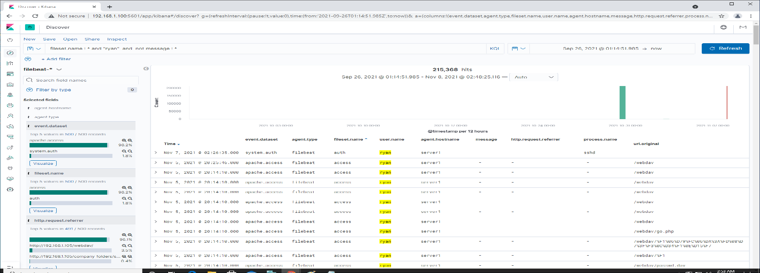
Analysis: Finding the WebDAV Connection
There were 215,368 events directed at the /webdav between 9/26/21 and 11/08/21
The following files were requested; go.php and passwd.dav

Slide 17
Blue Team
Proposed Alarms and Mitigation Strategies
‹#›

Slide 18
Mitigation: Blocking the Port Scan
IDS/IPS systems can be setup to detect brute force attacks
Reports can be created to monitor when Ack request are sent to test the whole ip range and then report back to a single ip
Actions to block further incursions into the system can then be taken if necessary.
Alarm threshold can be based on if the ip is recognized.
You can turn off response to ping.
Readdress common ports and ip addresses

Slide 19
Mitigation: Finding the Request for the Hidden Directory
We could write a report to collect when known hidden folder access is requested with linux ls -a, if access was granted or not, and set an alarm threshold based on how many - access not granted we get.
You would have to take a look at the norm for access not granted types and then set a threshold to avoid false positives..etc..
To hide files that should not be seen we could use - chmod <directory_name> 700, and place the hidden files inside this folder. Otherwise ls -a will be able to see the hidden files.

Slide 20
Mitigation: Preventing Brute Force Attacks
Create a report and alert that monitors each login point and sends an alarm when user have unsuccessfully attempted to login more that 7 times.
Harden all login points to shut out a user at that point after 7 failed attempts

Slide 21
Mitigation: Detecting the WebDAV Connection
Create a reports that monitors attempts to login to the webDav. Send alert emails to Sysops when brute force attack levels are detected.
Set login authentication threshold to lock user out after a 7 failed login attempts many
Disable respond to ping
Monitor Ack request to the webDav and send an alarm when request are above normal.
Snort Rule to isolate the webdav access and only allowing access to known ip’s of specific machines and users/groups.
Add authentication to web server index directory. Remove message files and plan text in general and specifically remove text message with instructions on how to access the webDav
Encrypt data at rest

Slide 22
Mitigation: Identifying Reverse Shell Uploads
More robust username and password requiring - password expiration and renewal. Safer password with upper & lower case + symbols and numbers
User training
Passwords should lock account out after 7 attempts
Escalated user/group privileges necessary to write files to the system/Dav for groups who need it only.
Scan files on upload. Auto remove files with malicious content before committing to disk.
Auto lockout for more than 7 password attempts - require password reset in a totally different and harden environment to access the system back at the locked point

